Slide 1
COP 4530 GROUP PROJECT
Hoang Nguyen, Jorgo Nasto, Kin Ng Lugo, Nam Nguyen

Slide 2
TEAM WYOMING
Hoang Nguyen
Nam Nguyen
Jorgo Nasto
-Requirements Generator
Kin Ng Lugo
-Developer
-Developer
-Tester

Slide 3
TEAM CONTRIBUTION
-Requirements Generator(Hoang Nguyen):
Find resources that help developers
Assign roles to work on the project
Generate test cases and test functions
Designed and worked on the Powerpoint and presentation
-Developer(Kin Ng Lugo):
Coding to get the program to run correctly.
Worked intensively on the following functions:
empty
size
height
front
back
clean
-Developer(Nam Nguyen):
Coding to get the program to run correctly.
Worked specifically on the following functions:
member
insert
erase
clear
breadth_first_traversal
-Tester(Jorgo Nasto):
Put together the Powerpoint
Testing all the functions after completion.
Testing the code with invalid inputs and several
bad numbers to check how the code behaved.
Helped with some code in the beginning of the project.

Slide 4
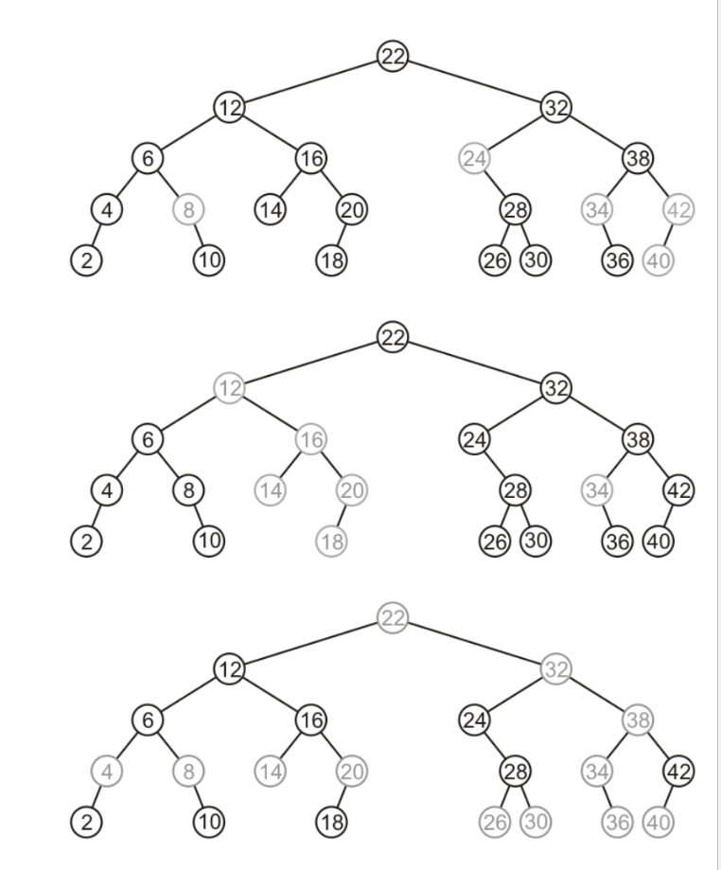
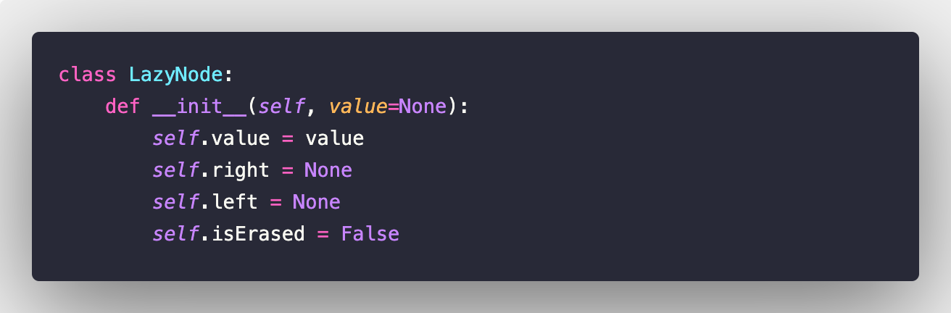
LAZY DELETION
TREE
What is it?
Basically a binary search tree with 1 condition:
Objects erased are simply tagged as erased while the nodes remain in the tree

Slide 5
OUR ASSIGNMENT
The class that implements the lazy deletion tree, tagging as erased the nodes that are erased.
Creating the functions asked:
Accessors:
Empty
Size
Height
Member
Front
Back
Breadth First Traversal
Mutators:
Insert
Erase
Clear
Clean

Slide 6
PROJECT STAGES
STEP 3
STEP 2
STEP 4
STEP 1
Get all the Mutator functions working
Creation of the class for the tree
Get all the accessor functions working
Testing to make sure the functions work with different scenarios

Slide 7
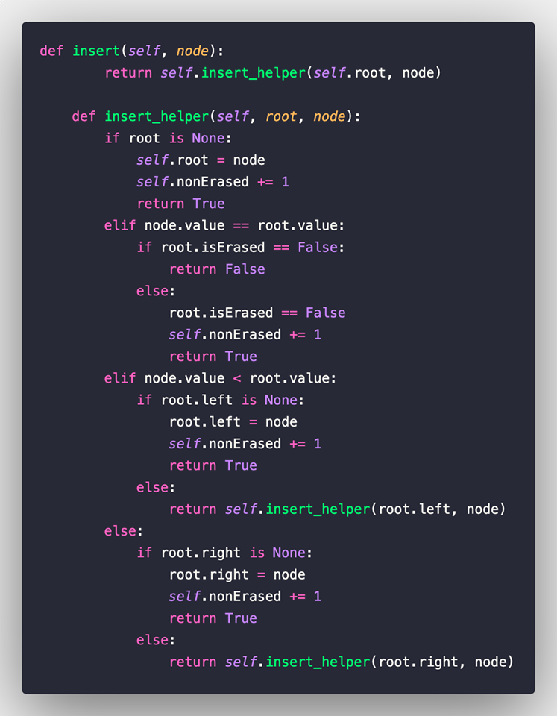
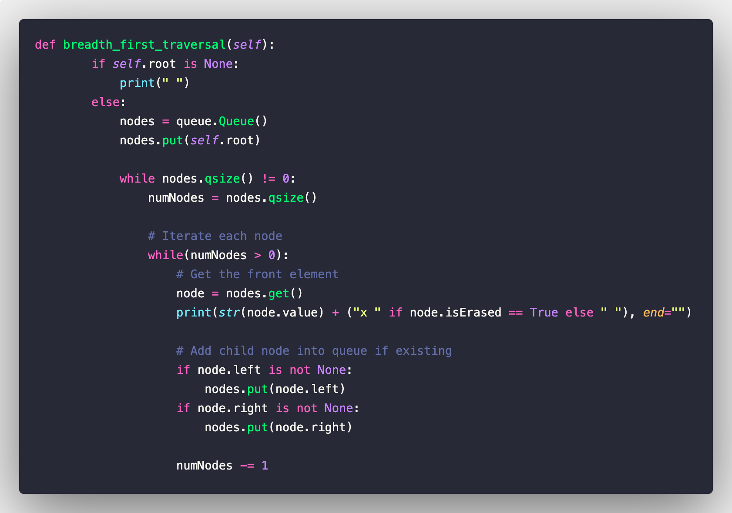
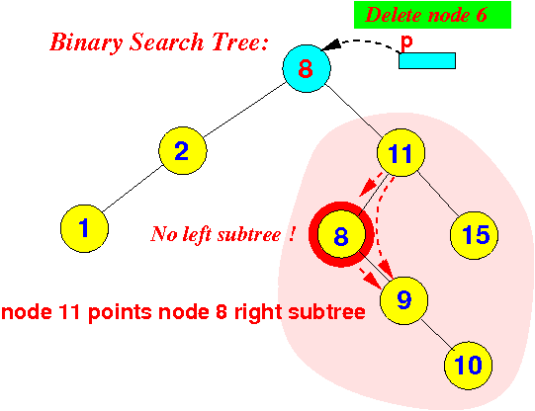
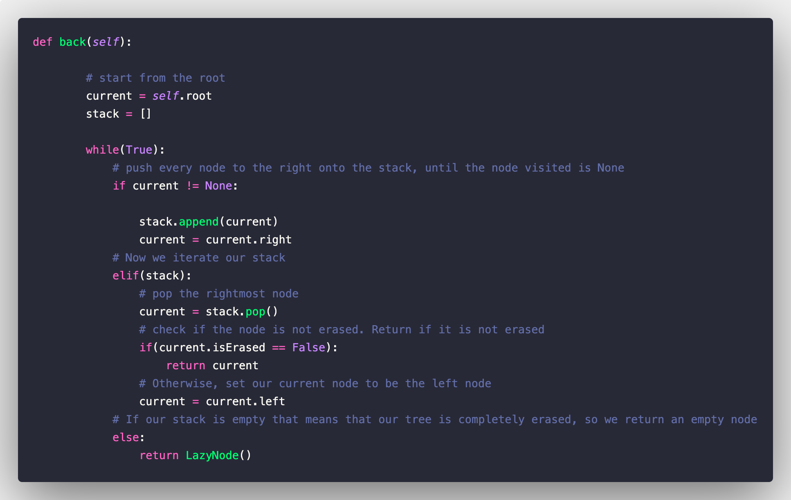
ALGORITHMS
Breath_first_traversal: Use Queue principal to traverse by levels
Front_and_back: In order traversal
Insert: Binary search
Clean: Depth-first Search

Slide 8
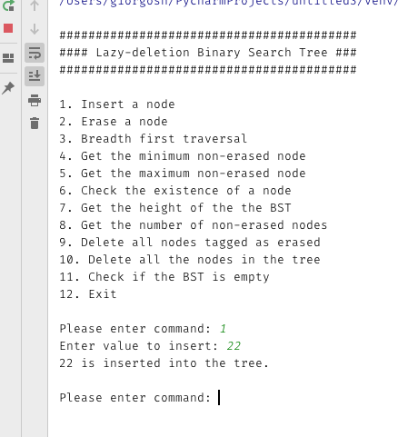
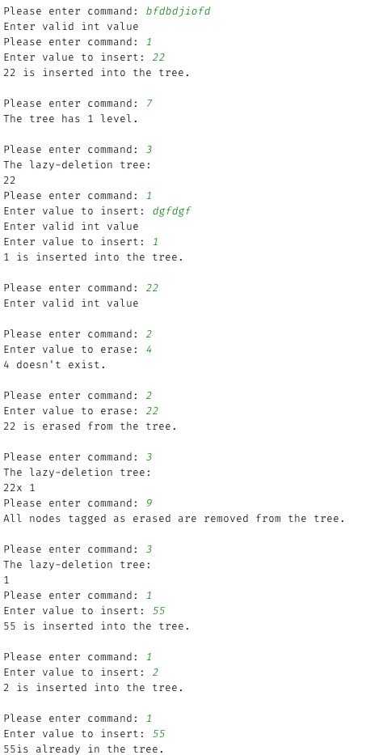
TESTING
Deciding on what inputs to use
Project Requirements
The case of the Empty Tree
Bad Data
Special Testing API
Timing

Slide 9
ISSUES DURING THE PROJECT
CREATING THE FUNCTIONS
ALGORITHMS
RUNTIME
PANDEMIC ISSUES

Slide 10
SOLVING THE ISSUES
Spend time reading about binary tree
Assign roles properly
In-depth research
Ask questions
Divide the workload

Slide 11
CONCLUSION
Lazy Deletion Trees
Algorithms
Working As a Developing Team

Slide 12
THANK YOU FOR LISTENING!
Do you have any question for us?

